Slide 1
Brand Equity Components II: Brand Associations

Slide 2
Overview
Definition of brand associations
Types of associations
Dimensions of brand associations
Value of brand associations

Slide 3
Brand Associations
Definition: A brand association is any piece of knowledge, a feeling, an image, or other information linked to the brand in the mind of the consumer. The total set of such brand associations is known as brand meaning or brand image.

Slide 4
Types of Brand Associations
Competitors
Product
Attributes
Country/
Geographic Area
User/
Customer
Intangibles
Product
Class
BRAND
Name and
Symbol
Celebrity/
Person
Use/
Application
Customer
Benefits
Life Style/
Personality
Relative
Price

Slide 5
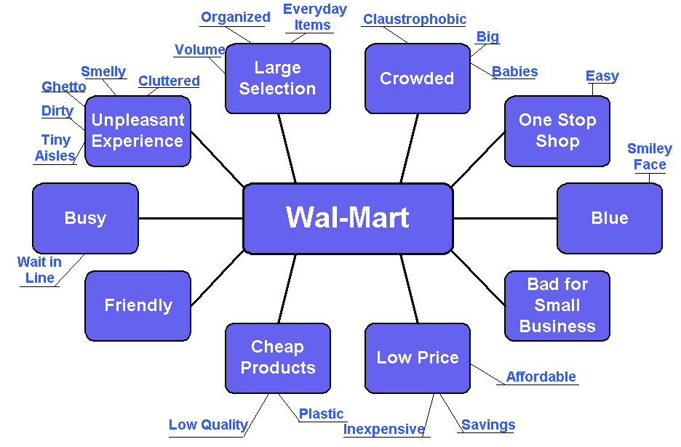
Wal-Mart Associations

Slide 6
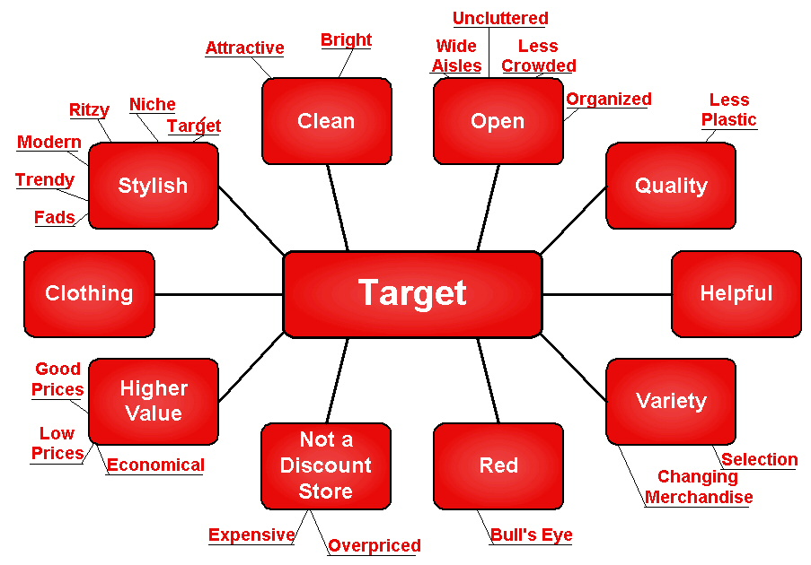
Target Associations

Slide 7
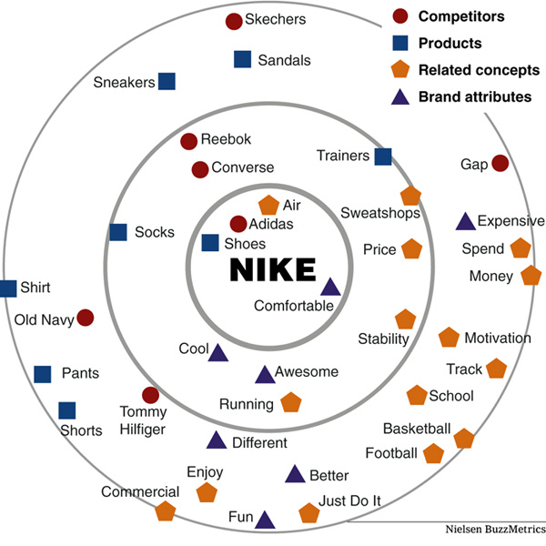
NIKE ASSOCIATIONS

Slide 8
Dimensions of Brand Associations
Strength
  Personal relevance
  Consistency
Favorability
  Desirable
  Product-relevant
Uniqueness
  Points-of-difference
  Relevant

Slide 9
The Value of Brand Associations
Differentiate/Position
Reason-to-Buy
Create Positive Attitude/Feelings
Basis for Extensions
ASSOCIATIONS

Slide 10
Thought Experiment: What are Your Firm’s Brand Associations?

Slide 11
End of Lecture

